Slide 1
SURF ISLO HISTORY AND RESULTS
Shannon Gracey
Coordinator, Student Learning Outcomes Assessment Committee

Slide 2
INITIAL ISLO ASSESSMENT METHOD
Course mapping
Stratified data by ADM ranking
Randomly selected from courses which were ranked as 5’s
Set competency level
Results were found by (# of CSLOs which met competency)/(total # of CSLOs)
Pros and Cons

Slide 3
ALL COLLEGE DAY: ISLOS SPRING 2014
All faculty, administrators, and staff were invited to provide input on ISLOs
Should the ISLOs be changed?
What is meant by “critical thinking”?
How should the ISLOs be assessed?
When using course mapping, how should the courses be selected?

Slide 4
5TH FRIDAY: ISLOS SPRING 2014
All faculty and administrators were invited to focus groups developed from the All College Day event
Focus groups
Critical thinking
Different methods of assessment?
Course mapping
PSLO focus groups
Watson-Glaser Critical thinking assessment

Slide 5
THE SURF ISLO ASSESSMENT IS BORN
SURF ISLO subcommittee
Plan logistics with AIS
Develop a rubric

Slide 6
ASSESSMENT METHODS
We left it open so that faculty could explore different methods
Holistic/overall
Specific assessment item(s) to assess the CT ISLO
Other ideas?

Slide 7
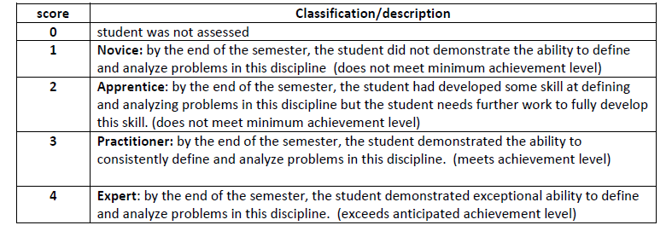
THE RUBRIC

Slide 8
OVERALL RESULTS
n = 4041 students
Participation rate: 3867/4041 ≈ 95.7%
A rubric score of at least 3 meets competency
Measure of Center
Median rubric score is 3
Mode is a rubric score of 3
Competency has been met

Slide 9
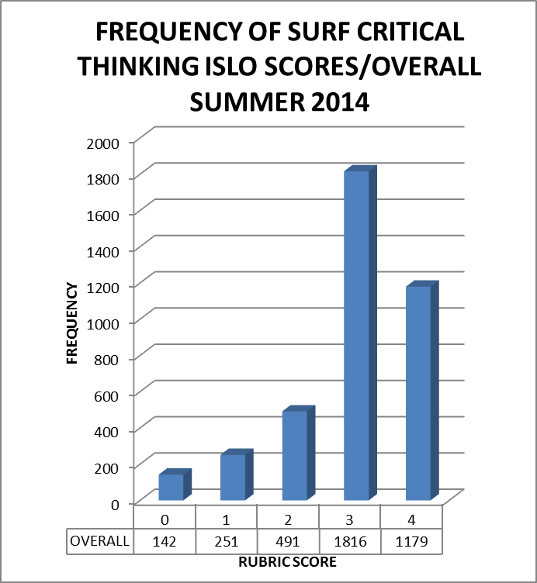
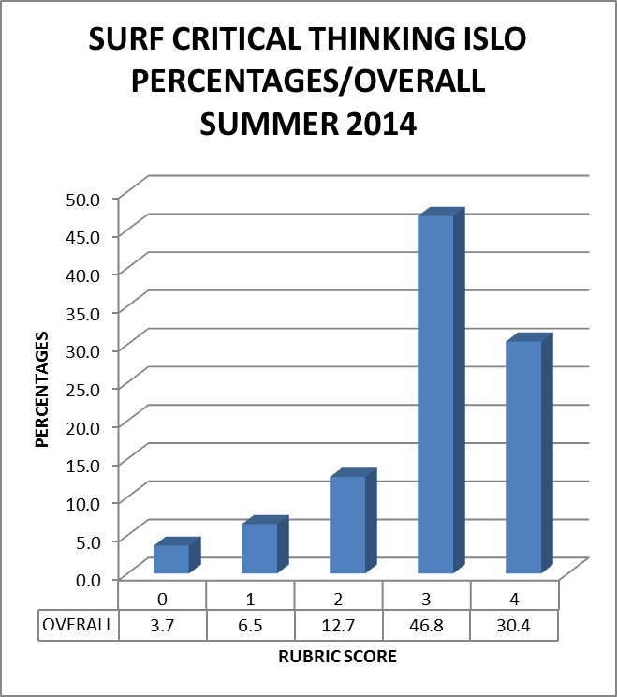
OVERALL ALL ASSESSED COURSES/STUDENTS

Slide 10
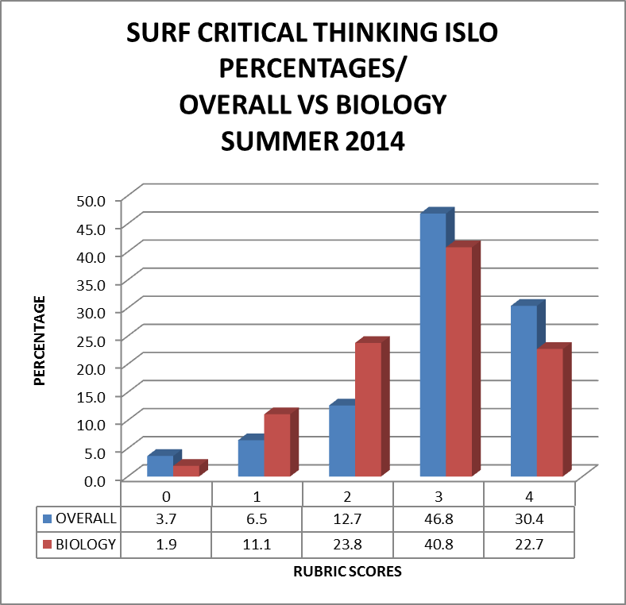
OVERALL VS BIOLOGY

Slide 11
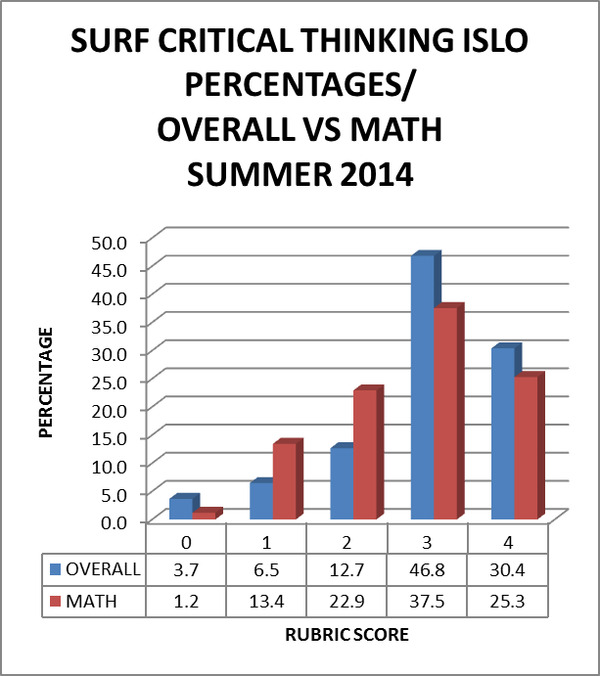
MATH VS OVERALL

Slide 12
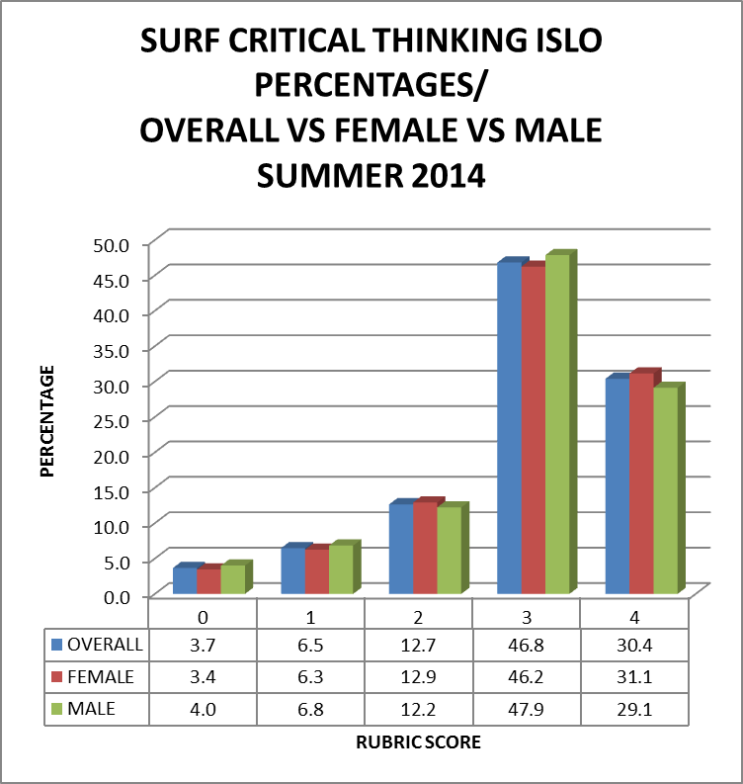
GENDER COMPARISON

Slide 13
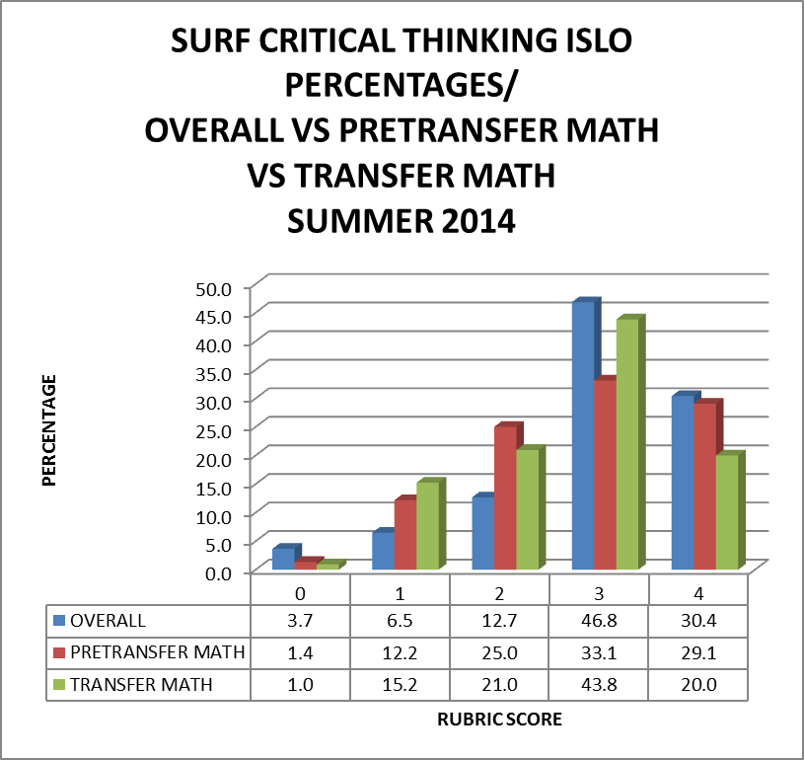
PRETRANSFER MATH VS TRANSFER MATH

Slide 14
NEXT STEPS
Assess all ISLOs
Should we continue to use this method?
Validation
Students’ right to know about the assessment
Other issues?

Slide 15
DATA
What information are you interested in seeing?
Age comparisons
Duplicated Students
All pretransfer vs transfer
Other suggestions?

Slide 16
STAFF DEVELOPMENT
What kind of staff development would you like to see for SLOs?
Assessment
PLO reflection in program review
Cross discipline
Other suggestions?

Slide 17
SLOAC DROP-IN OFFICE HOURS
Where: OC4603
When: Tentatively T/TH from 9-11 and W from 9-12

Slide 18
SHANNON GRACEY’S CONTACT INFORMATION
Email: sgracey@miracosta.edu
Phone: (760) 757-6306
Email is the ideal method of contact…

Slide 19
THANK YOU!
Just remember…you are an integral part of the SLO and accreditation process. We value your ideas!

